Slide 1

Views & Stored Procedures

Slide 2
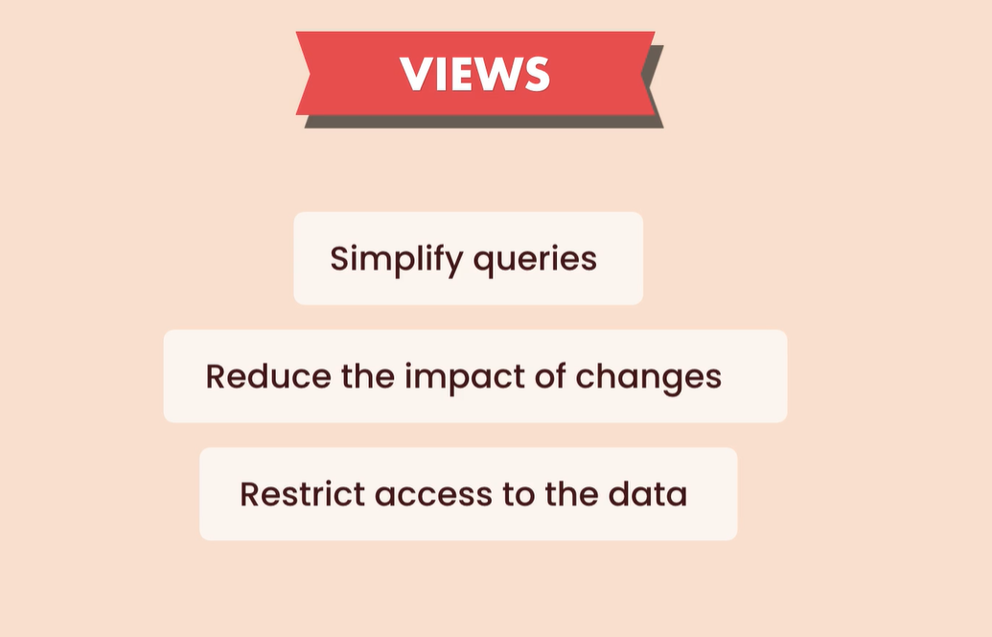
Reduce the impact: when u change the column name u just need to change the view because everything else depend on the views and not the table, because good design based on the views only and don’t work directly on the tables
Restrict access: we can return some of the data not all the data that we have in the table

Slide 3
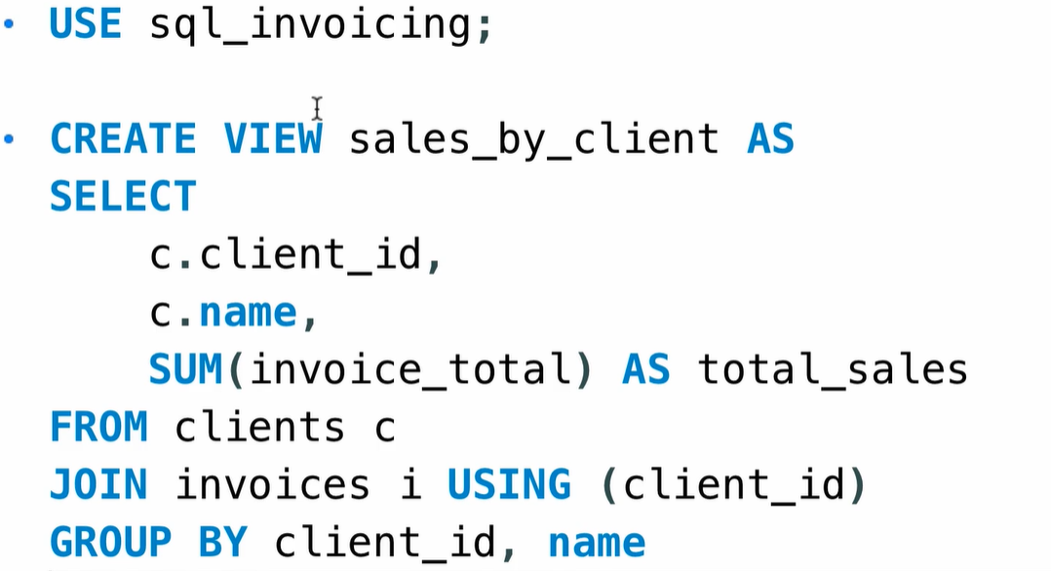

Views
We can save queries in a view, and this will greatly simplify our select statement, and then we can reuse these views.
Then as u see we can use this View just like a table

Slide 4
Exercise
Create a view to see the balance for each client. (clients_balance) add this columns
client_id, name, balance hint tables to use => clients, invoices
hint => invoice_total – payment_total = balance

Slide 5
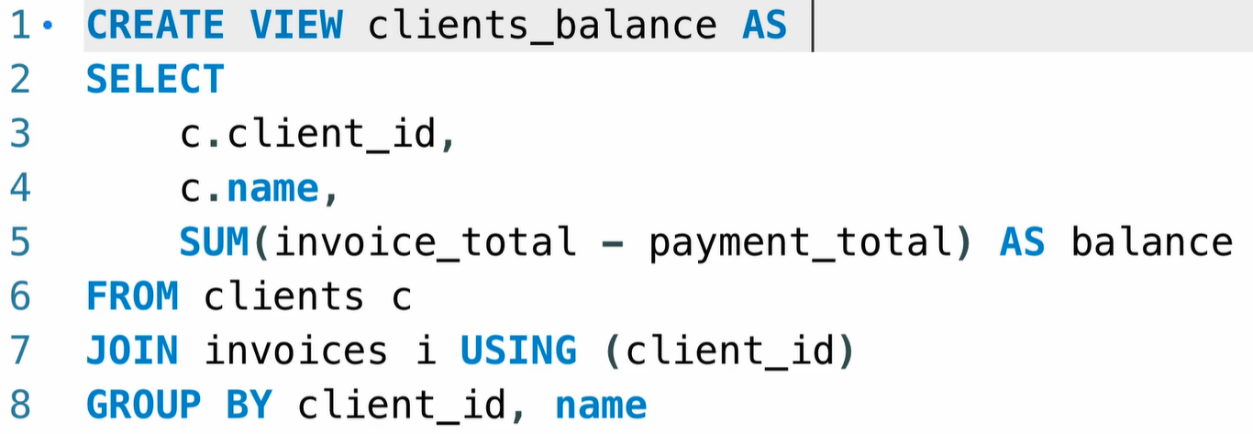
Solution

Slide 6
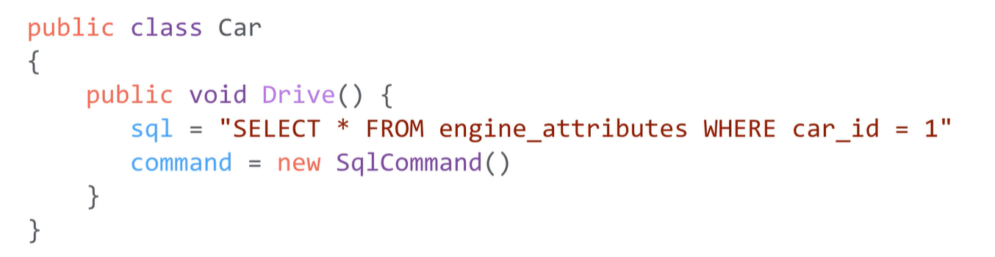
What is Sored Procedures
SQL statement ? You’re not going to write them in your application code for couple of reasons. One reason is it will make your application code messy and hard to maintain.
Once u have to change the sql u don’t need to compile the code

Slide 7
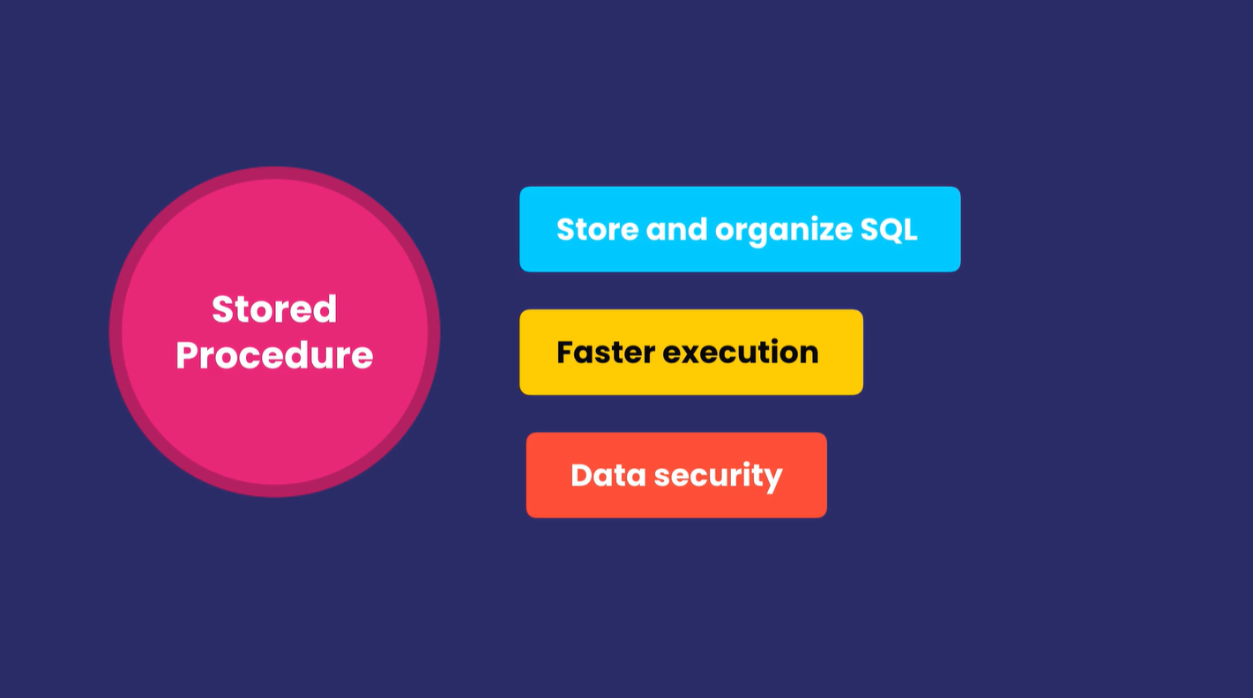

Slide 8
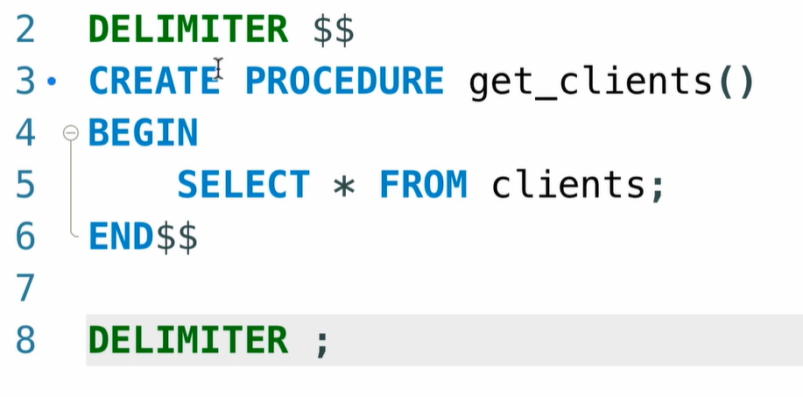
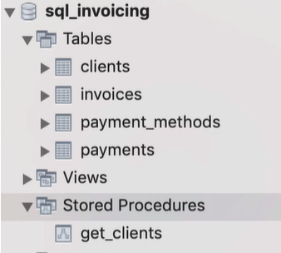
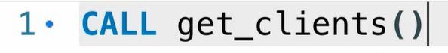
Example
After statement u need to end it with ;
Statement between BEGIN and END
In MYSQL to enforce MYSQL to run all the what we wrote in single unit we need to change the default delimiter

Slide 9
Exercise
Create a stored procedure called get_invoices_with_balance
Return all the invoices with a balance > 0
Hint: invoices table
balance > 0

Slide 10
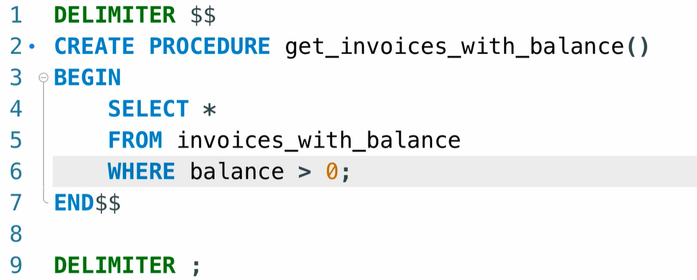
Solution

Slide 11
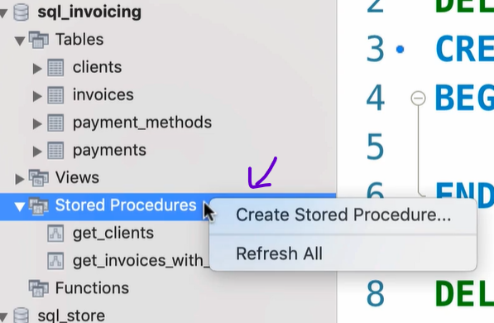
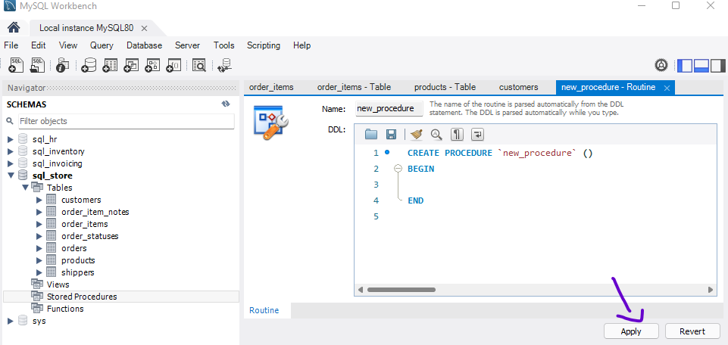
Creating Procedures Using MySQLWorkbench
In this way we don’t need to take care of the default Delimiter the SQLWorkbench will take care about it see after clicking apply

Slide 12
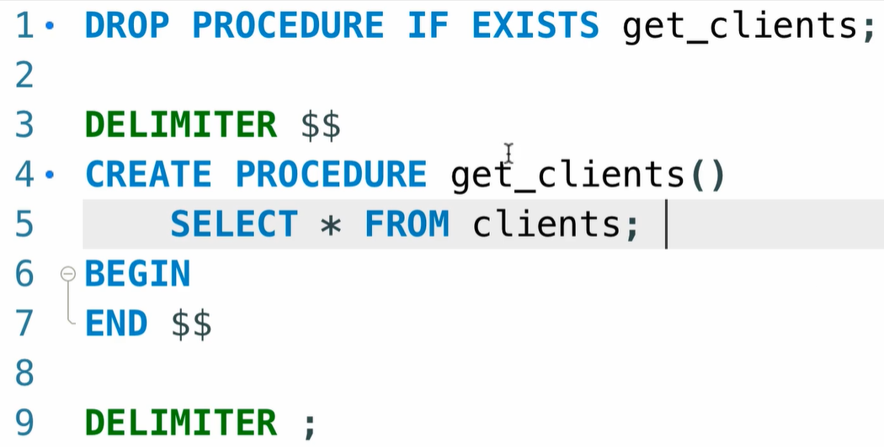
Dropping Stored Procedures

Slide 13
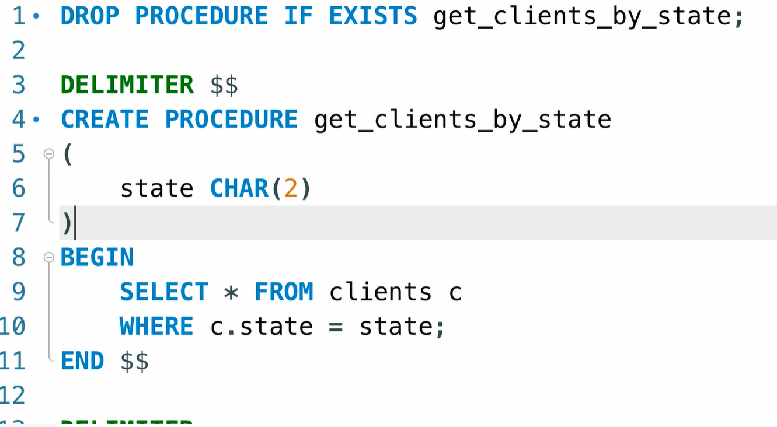
Parameters

Slide 14
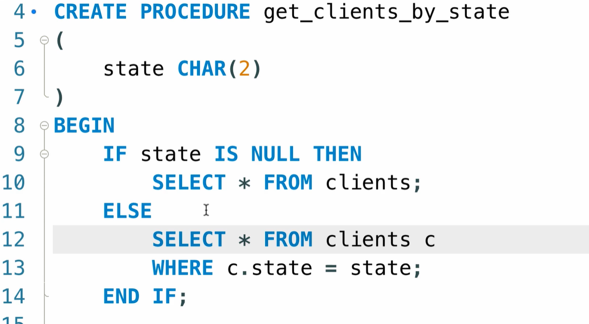
Parameter with Default values

Slide 15
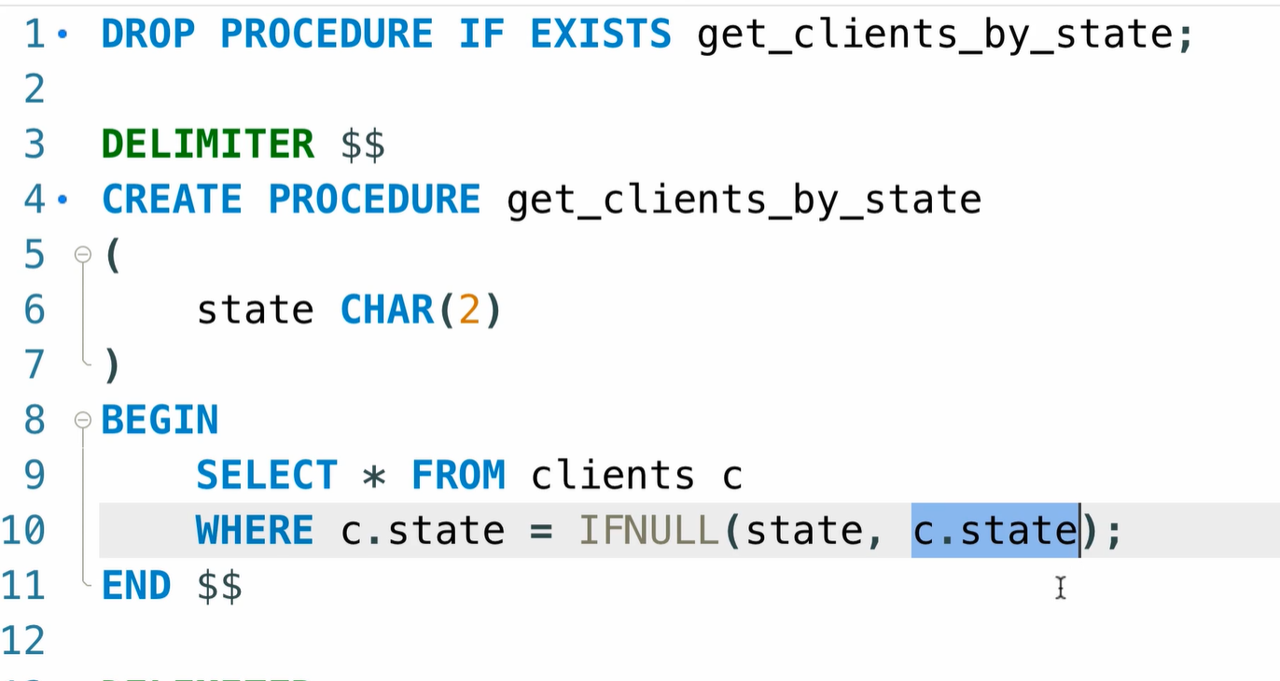
Parameter with Default values

Slide 16
Exercise
Write a stored procedure called get_payments with two parameter:
Client_id =>INT(4)
Payment_method_id => TINYINT(1) 0-255

Slide 17
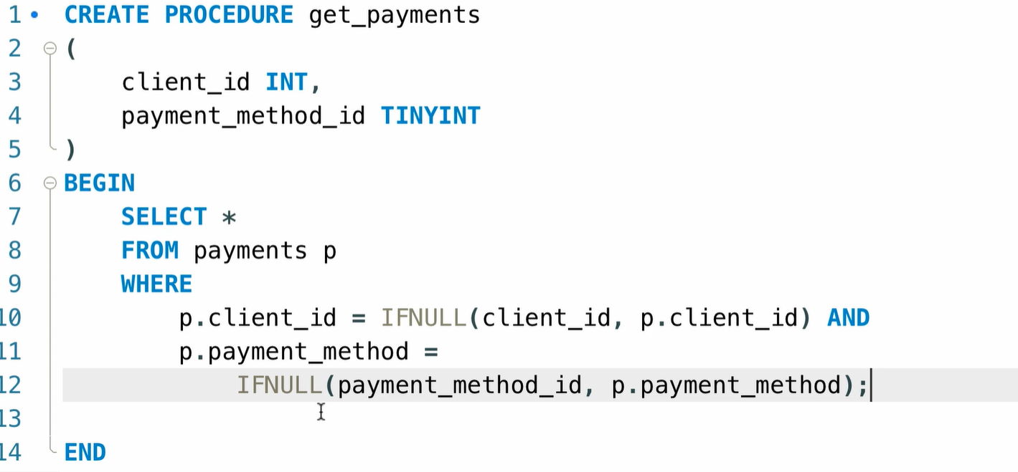
Solutions

Slide 18
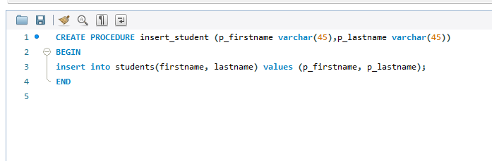
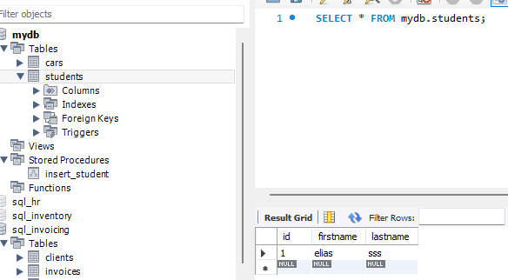
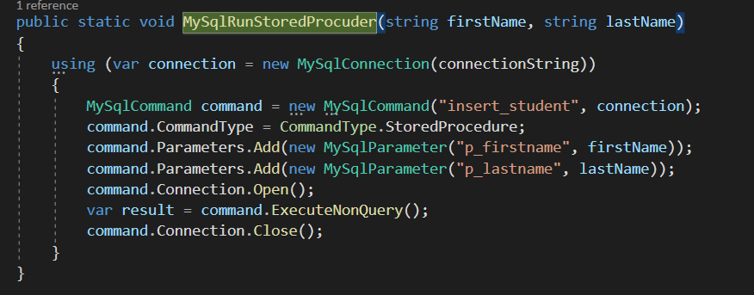
Add student

